Slide 1
Python…… via Ansible
John Navitsky
Notes:
Interested in Python for all the Mundane reasons, but will try not to talk about those.
Less direct ways Python can be of interest.

Slide 2
Look, if he was dying, he wouldn't bother to carve "Aaargh."
Notes:
Get it out of the way.
Favorite Python… Holy Grail

Slide 3






Notes:
Crazy dog person

Slide 4
A problem
Say you had 20-50K “computers” (nodes) to configure
Say they (mostly) didn’t have persistent storage
Say they don’t have a uniform configuration
Say you needed to get all these nodes booted and configured relatively quickly… at the same time
Notes:
Mundane … for work
Systems Engineer
But… last ten years in programming group

Slide 5
Tenants
Separation of configuration, content
Configuration and content shall be managed

Slide 6
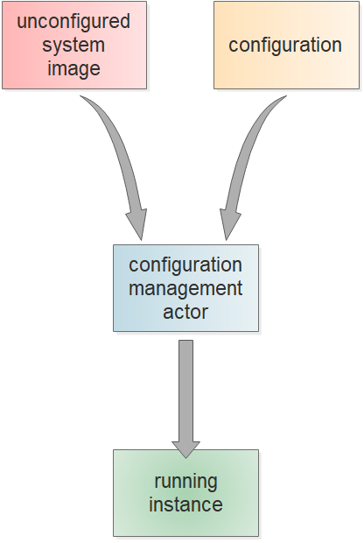
An approach
Application of configuration to unmanaged image at boot time
“Pull” model to facilitate scalability

Slide 7
An actor
Ansible
Simple
Modular/Extensible
YAML/JSON variables
On-demand execution
Written in Python

Slide 8
Some Ansible
http://docs.ansible.com/ansible/latest/modules_by_category.html
http://docs.ansible.com/ansible/latest/playbooks_variables.html
http://docs.ansible.com/ansible/latest/playbooks_loops.html

Slide 9
Demo time!
Anatomy of an Ansible play
Example simple1: ntp servers
Example simple2: group data
Example simple3: things that make you go “hmmmm…”
Example less_simple: ouch

Slide 10
Takeaways
Data-structures
Python methods
The line between Ansible and Python is “wafer-thin”
Writing modules, filters

Slide 11


